Slide 1

Hypha ROS RaceCar Workshop 2017-06
Lecturer : HaoChih, LIN
林浩鋕
Website: https://hypharosworkshop.wordpress.com/contact/
FB Page: https://www.facebook.com/HyphaROS/
Email: hypha.ros@gmail.com

Slide 2
6/10 (週六) |  |  | 6/11 (週日)
時段 | 課程 | 教室 | 時段 | 課程 | 教室
10:00 12:00 | 課程介紹 2D SLAM | 綜合教學大樓 | 09:00 12:30 | Navigation & Amcl Simulation | 綜合教學大樓
12:00 13:30 | 中午休息 (自行外出用餐) |  | 12:30 14:00 | 中午休息 (自行外出用餐)
13:30 15:30 | Laser Odom EKF (IMU+Odom) | 綜合教學大樓 | 14:00 15:30 | System Integration | 工學院交誼廳
休息10分鐘
15:40 18:30 | Base Controller & Path following | 綜合教學大樓 | 15:40 16:50 | Final Testing & Debugging | 工學院交誼廳
18:30 20:00 | 晚餐時間 (自行外出用餐) |  | 17:00 18:00 | Competition | 工學院交誼廳
20:00 21:30 | 硬體Debug (此時段非必要,依需求) | 綜合教學大樓 | 18:00 ~ | 工作坊結束
https://hypharosworkshop.wordpress.com/
Copyright © 2017 Hypha ROS Workshop. All rights reserved
Lecturer: HaoChih, LIN
Notes:
工作坊 基本介紹 （我們是誰）
兩日注意事項 （貴重物品 垃圾 午餐 晚餐 水 廁所 debug時間 隔天最終場地等）
不得錄音 錄影 可以拍照
code部份 都公開
有問題可以發問 但因為時間有限 所以太過細節部份 建議debug時段提問

Slide 3
ROS X Odroid (Basic operation)
2D SLAM algorithms implementation & comparsion
gmapping
hector slam
mrpt-icp
Odometry Estimation
laser Odom (rf2o pkg)
fused with IMU (by robot_localization pkg)
gmapping based on fused odom
Communication & Control
rosserial arduino
Teleop testing
L1 controller
Path planning test (movebase)
Hardware Debug [optional]
https://hypharosworkshop.wordpress.com/
Copyright © 2017 Hypha ROS Workshop. All rights reserved
Lecturer: HaoChih, LIN

Slide 4
ROS X Odroid (Basic operation)
https://hypharosworkshop.wordpress.com/
Copyright © 2017 Hypha ROS Workshop. All rights reserved
Lecturer: HaoChih, LIN

Slide 5
ROS X Odroid (Basic operation)
[desktop] Download pkg from Hypha-ROS github
$ cd catkin_ws/src
$ git clone https://github.com/Hypha-ROS/hypha-racecar
[desktop] SSH/Remmina to Odroid
Wifi configuration (ad-hoc pw: 1234567890, SSID: hypha0X)
Ethernet configuration
ROS multi-machine env setting (in hypha-racecar/document/ROS_multiMachine/)
ssh → $ ssh odroid@192.168.XX.1 (pw: hypharos)
remmina (vino pw: 0000)
[odroid] Modify wifi setting
sudo gedit /etc/network/interfaces (pw: hypharos)
ROS multi-machine env setting (in bashrc)
https://hypharosworkshop.wordpress.com/
Copyright © 2017 Hypha ROS Workshop. All rights reserved
Lecturer: HaoChih, LIN

Slide 6
ROS X Odroid (Basic operation)
[desktop] image backup
Read: In hypha-racecar/document/commands/
$ sudo fdisk -l /dev/sdb
$ sudo dd if=/dev/sdb bs=512 count=29624319 of=~/HyphaROS_xu4_kinetic_20170610.img
Write: Ubuntu GUI
[odroid] Change git config
$ cd catkin_ws/src
$ git config --global user.name "YOUR NAME"
$ git config --global user.email YOUR EMAIL
$ git config --list (to ckeck setting)
https://hypharosworkshop.wordpress.com/
Copyright © 2017 Hypha ROS Workshop. All rights reserved
Lecturer: HaoChih, LIN

Slide 7
ROS X Odroid (Basic operation)
[odroid] Create your own ROS pkg
$ cd catkin_ws/src
$ catkin_create_pkg PACKAGE_NAME geometry_msgs move_base tf roscpp rospy std_msgs visualization_msgs
[odroid] Udev Setting
$ lsusb (check the idV and idP of each component)
Select one for finding the ISB port
$ ls dev/ttyACM or ttyUSB
$ udevadm info -a /dev/ttyUSB0
$ sudo gedit /etc/udev/rules.d/99-NAME.rule
⇒ KERNEL=="ttyUSB*", ATTRS{idProduct}=="ea60", ATTRS{idVendor}=="10c4", MODE="666", ATTRS{devpath}=="1.2.1.2", SYMLINK+="rplidar
https://hypharosworkshop.wordpress.com/
Copyright © 2017 Hypha ROS Workshop. All rights reserved
Lecturer: HaoChih, LIN

Slide 8
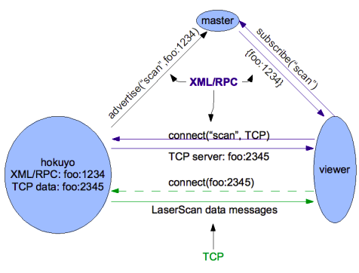
ROS X Odroid (Basic operation)
[concept] Establishing a topic connection
Subscriber starts.
Publisher starts.
Subscriber registers with the Master. (XMLRPC)
Publisher registers with the Master. (XMLRPC)
Master informs Subscriber of new Publisher. (XMLRPC)
Subscriber contacts Publisher to request a topic connection and negotiate the transport protocol. (XMLRPC)
Publisher sends Subscriber the settings for the selected transport protocol. (XMLRPC)
Subscriber connects to Publisher using the selected transport protocol. (TCPROS, etc...)
figure source: http://wiki.ros.org/ROS/Technical%20Overview
https://hypharosworkshop.wordpress.com/
Copyright © 2017 Hypha ROS Workshop. All rights reserved
Lecturer: HaoChih, LIN

Slide 9
ROS X Odroid (Basic operation)
[tool] rostopic commands
rostopic bw display bandwidth used by topic
rostopic delay display delay for topic which has header
rostopic echo print messages to screen
rostopic find find topics by type
rostopic hz display publishing rate of topic
rostopic info print information about active topic
rostopic list print information about active topics
rostopic pub publish data to topic
rostopic type print topic type
[tool] rosbag commands
rosbag record -a
rosbag record --duration=5m
rosbag play --clock recorded1.bag
https://hypharosworkshop.wordpress.com/
Copyright © 2017 Hypha ROS Workshop. All rights reserved
Lecturer: HaoChih, LIN

Slide 10
ROS X Odroid (Basic operation)
[tool] roslaunch
http://wiki.ros.org/roslaunch/XML
See example
[tool] TF
http://wiki.ros.org/tf
http://wiki.ros.org/tf/Tutorials/Introduction%20to%20tf
http://wiki.ros.org/navigation/Tutorials/RobotSetup/TF
http://wiki.ros.org/urdf/Tutorials/Using%20urdf%20with%20robot_state_publisher#Create_the_URDF_File
$ tf_echo <source_frame> <target_frame>
static_transform_publisher (See example)
<launch>
<node pkg="tf" type="static_transform_publisher" name="base2laser" args="1 0 0 0 0 0 base_link laser_link 10" />
</launch>
https://hypharosworkshop.wordpress.com/
Copyright © 2017 Hypha ROS Workshop. All rights reserved
Lecturer: HaoChih, LIN

Slide 11
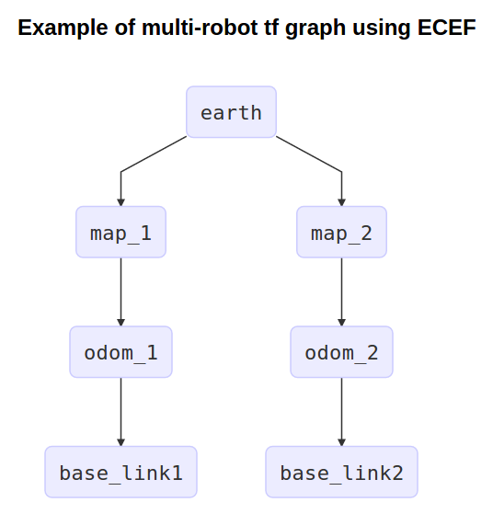
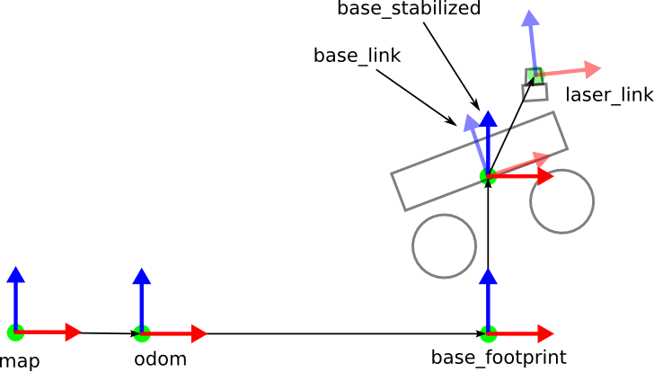
ROS X Odroid (Basic operation)
[concept] TF
http://www.ros.org/reps/rep-0105.html
figure source: http://www.ros.org/reps/rep-0105.html
figure source: http://library.isr.ist.utl.pt/docs/roswiki/hector_slam(2f)Tutorials(2f)SettingUpForYourRobot.html
https://hypharosworkshop.wordpress.com/
Copyright © 2017 Hypha ROS Workshop. All rights reserved
Lecturer: HaoChih, LIN

Slide 12
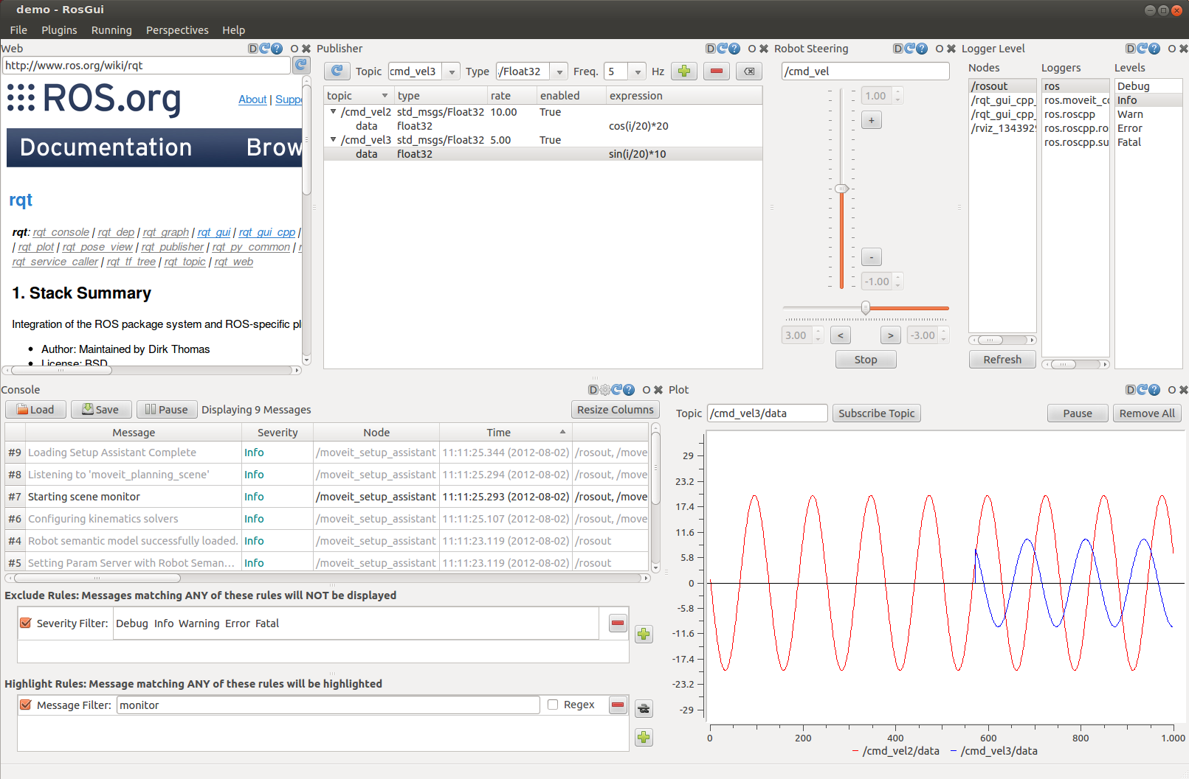
ROS X Odroid (Basic operation)
[tool] rviz
See example ($ roslaunch hypha_racecar desktop_gmapping.launch)
[tool] rqt
See example
https://hypharosworkshop.wordpress.com/
Copyright © 2017 Hypha ROS Workshop. All rights reserved
Lecturer: HaoChih, LIN

Slide 13
ROS X Odroid (Basic operation)
ROS Technical documents
[roslaunch] http://wiki.ros.org/roslaunch/XML
[rosbag] http://wiki.ros.org/rosbag/Commandline
[rostopic] http://wiki.ros.org/rostopic
[ros intro] http://wiki.ros.org/ROS/Introduction
[ros concept] http://wiki.ros.org/ROS/Concepts
[REP] http://www.ros.org/reps/rep-0000.html
http://wiki.ros.org/ROS/Technical%20Overview
http://docs.ros.org/indigo/api/catkin/html/index.html
http://wiki.ros.org/Remapping%20Arguments
http://wiki.ros.org/ROS/Master_Slave_APIs
https://hypharosworkshop.wordpress.com/
Copyright © 2017 Hypha ROS Workshop. All rights reserved
Lecturer: HaoChih, LIN

Slide 14
2D Laser SLAM
https://hypharosworkshop.wordpress.com/
Copyright © 2017 Hypha ROS Workshop. All rights reserved
Lecturer: HaoChih, LIN

Slide 15
2D Laser SLAM
Gmapping
needs external odom (in our case: laser odom fused with imu0)
Rao-Blackwellized Particle Filter (RBPF)
Loop closure
Hector SLAM
Gauss-Newton approach
External odom is not necessary
No loop closure
Requires high quality sensor (e.g. UTM-30LX)
Supports EKF fusion (imu)
MRPT-ICP SLAM
ICP algorithm
For small to mid-sized maps
External odom is not necessary
https://hypharosworkshop.wordpress.com/
Copyright © 2017 Hypha ROS Workshop. All rights reserved
Lecturer: HaoChih, LIN

Slide 16
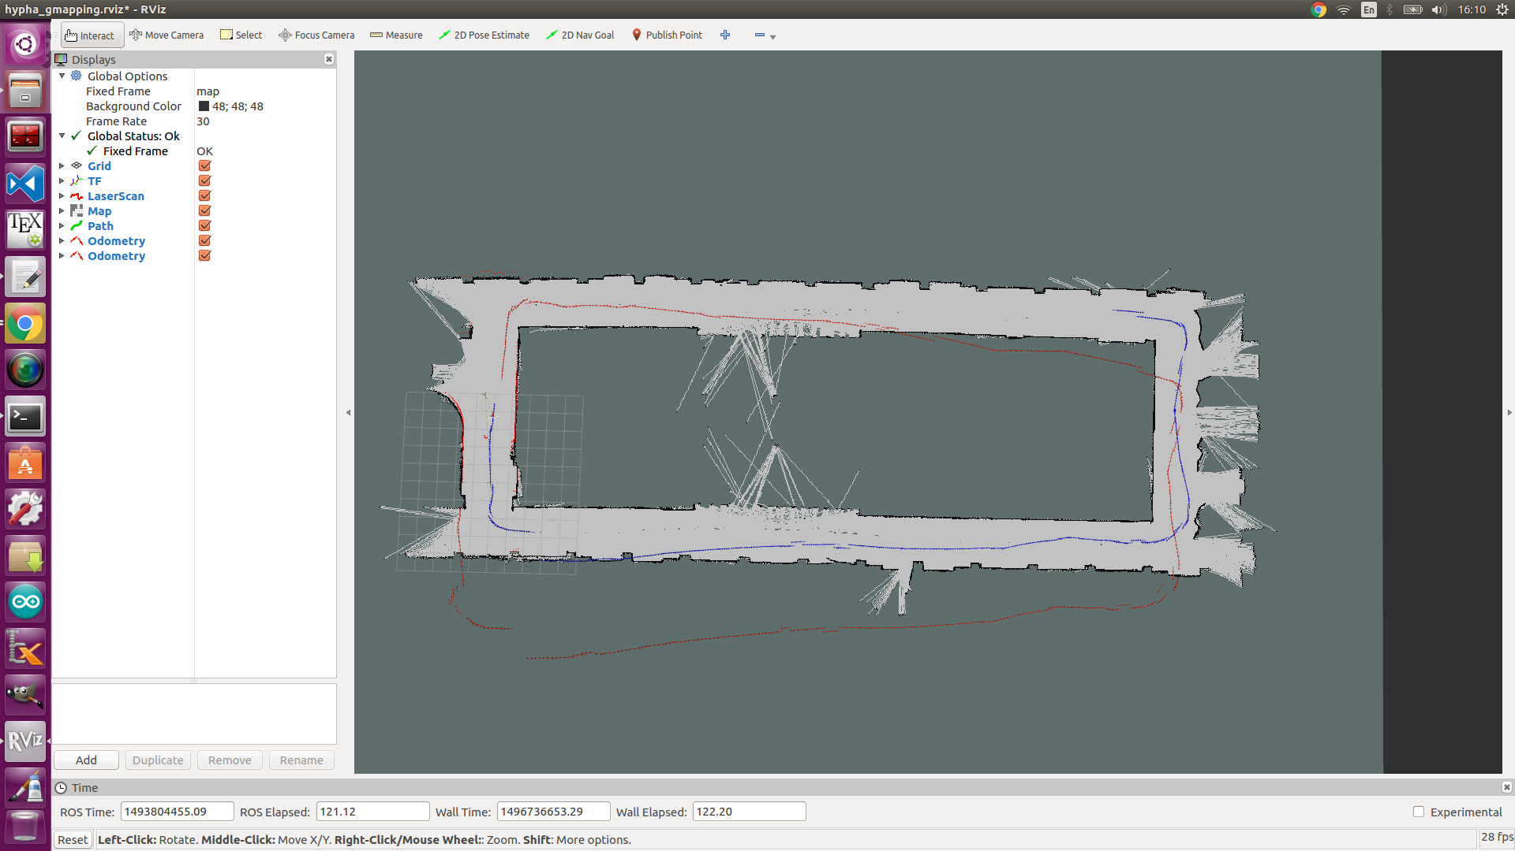
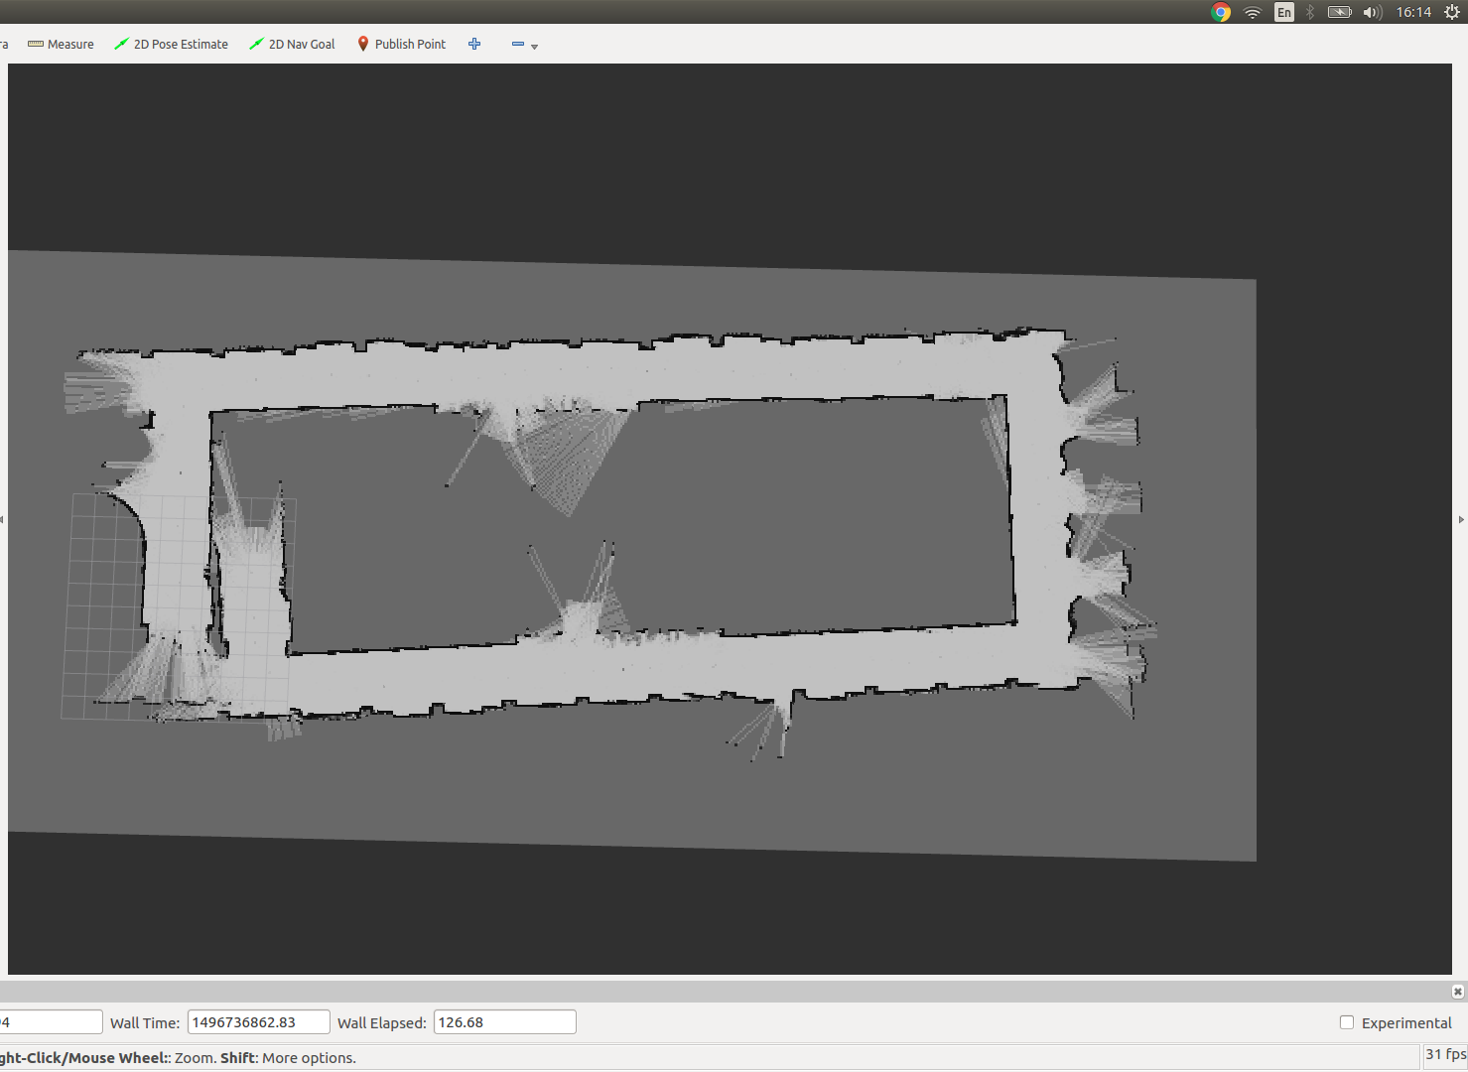
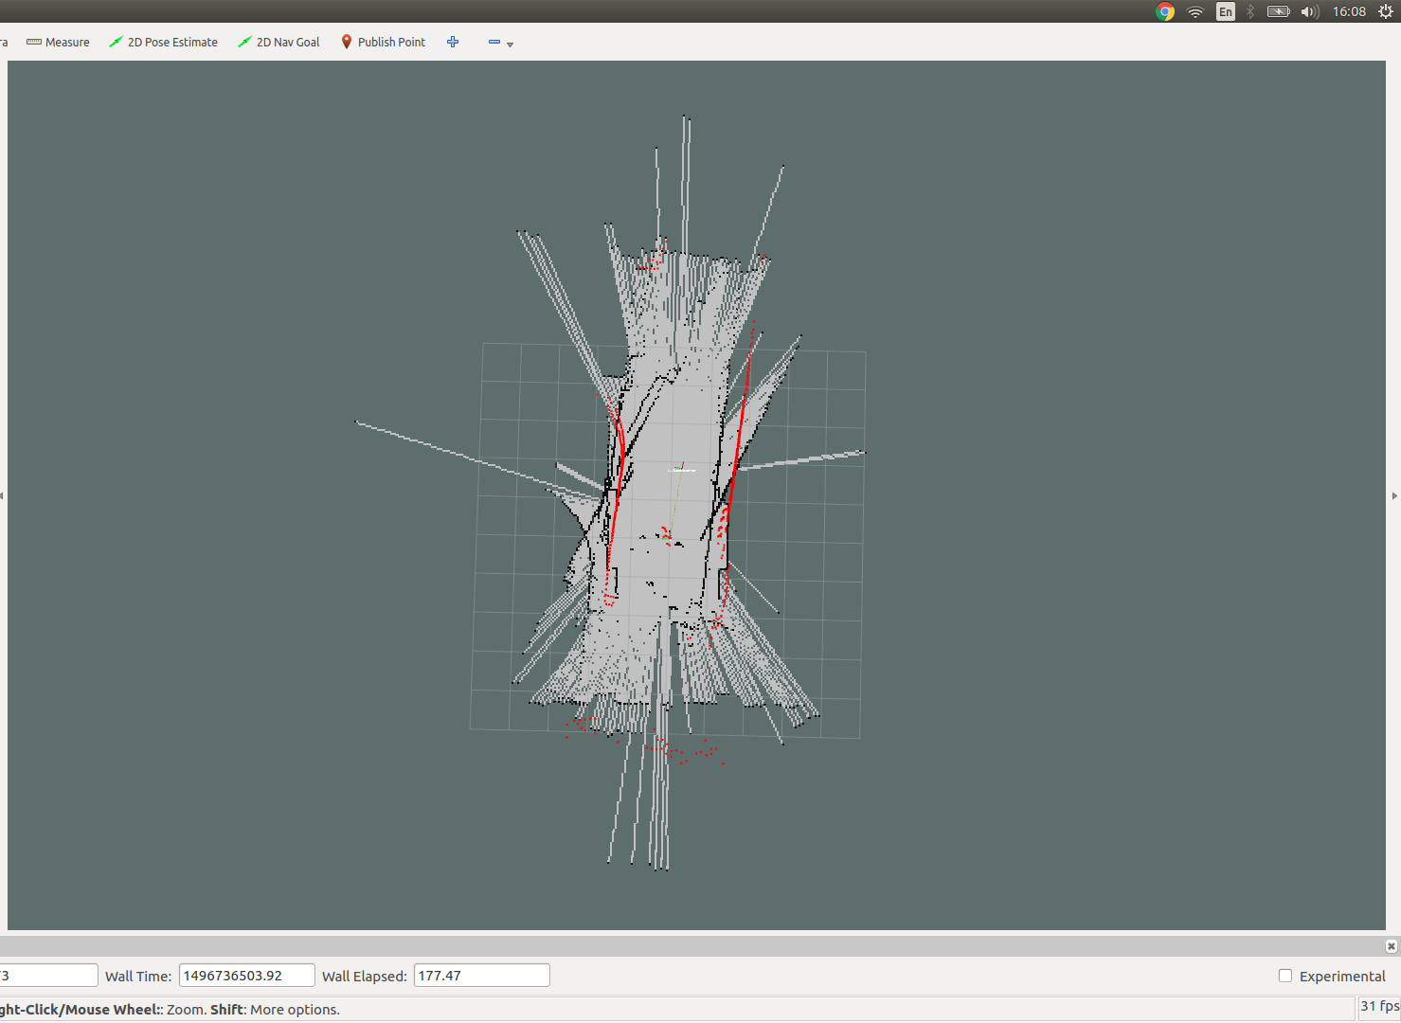
2D Laser SLAM
Gmapping
$ roslaunch hypha_racecar desktop_gmapping.launch
MRPT-ICP SLAM
$ roslaunch hypha_racecar desktop_icp_mapping.launch
Hector SLAM
$ roslaunch hypha_racecar Test_hector_rplidar.launch
gmapping (laser odom)
mrpt icp
hector slam
https://hypharosworkshop.wordpress.com/
Copyright © 2017 Hypha ROS Workshop. All rights reserved
Lecturer: HaoChih, LIN

Slide 17
Laser Odom (EKF IMU)
https://hypharosworkshop.wordpress.com/
Copyright © 2017 Hypha ROS Workshop. All rights reserved
Lecturer: HaoChih, LIN

Slide 18
Laser Odom (EKF IMU)
Odometry resource selection
Wheel encoder
Most reliable (in low speed)
Slip/Drifting Issue
Custom codes
Laser odometry
Performance depends on laser resolution/environment features
Good estimates in translation, awful in rotation
Better system portability
Visual Odometry (or Visual Inertial Odometry)
Low robust
High computational loading
Case by case tuning
Highly depends on sensor type/quality
https://hypharosworkshop.wordpress.com/
Copyright © 2017 Hypha ROS Workshop. All rights reserved
Lecturer: HaoChih, LIN

Slide 19
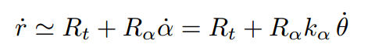
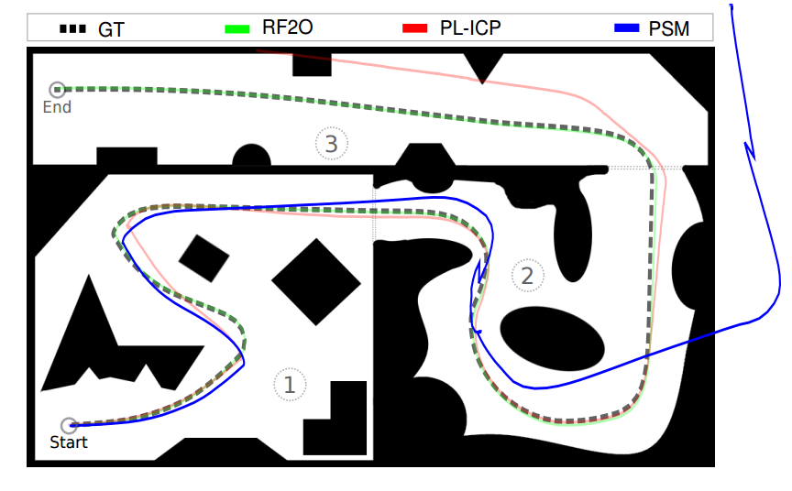
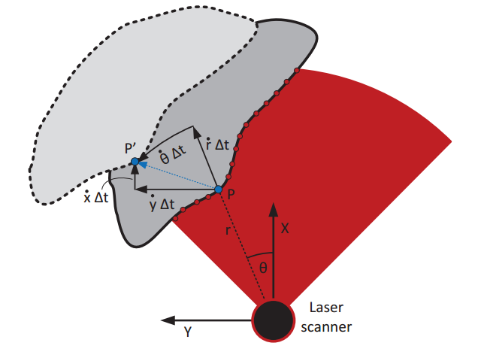
Laser Odom (EKF IMU)
rf2o laser odom package
http://mapir.isa.uma.es/mapirwebsite/index.php/mapir-downloads/papers/217
range flow constraint equation
Iteratively Reweighted Least Squares (IRLS)
figure source:
Planar Odometry from a Radial Laser Scanner. A Range Flow-basedApproach
https://hypharosworkshop.wordpress.com/
Copyright © 2017 Hypha ROS Workshop. All rights reserved
Lecturer: HaoChih, LIN

Slide 20
Laser Odom (EKF IMU)
Problem of rf2o
Performance of rf2o is bad in rotation behavior
Needs external measurement to estimate yaw motion (gy85)
ROS EKF Package
robot_pose_ekf
move_base built-in pkg
for 2D, low flexibility
robot_localization
all params are adjustable, well documented
3D model based
supports multi-sensors (including GPS, imu, vo, etc)
ethzasl_msf
ESKF architecture (imu derived model)
good for VO measurement
best choice for drone
https://hypharosworkshop.wordpress.com/
Copyright © 2017 Hypha ROS Workshop. All rights reserved
Lecturer: HaoChih, LIN

Slide 21
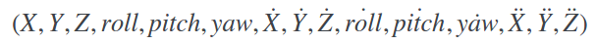
Laser Odom (EKF IMU)
robot_localization pkg
http://wiki.ros.org/robot_localization
https://github.com/cra-ros-pkg/robot_localization
[document] http://docs.ros.org/indigo/api/robot_localization/html/index.html
[video] https://vimeo.com/142624091
All state estimation nodes track the 15-dimensional state of the vehicle:
Implementation (See example file: "hypha_ekf_params.yaml") Vx, Vy from rf2o, yaw from imu, custom covariance settings
https://hypharosworkshop.wordpress.com/
Copyright © 2017 Hypha ROS Workshop. All rights reserved
Lecturer: HaoChih, LIN

Slide 22
Laser Odom (EKF IMU)
IMU yaw reading
[arduino] http://wiki.ros.org/razor_imu_9dof
[odroid] gy85 with modified pySerial code
Using gyro_z raw data for integration directly instead of output data from ekf
See example (file: imu_auto.py)
Ros bag Testing
Try to modify ekf param file (desktop_gmapping.launch)
Realtime onboard testing
Test_laser_odom.launch
Test_gmapping.launch
https://hypharosworkshop.wordpress.com/
Copyright © 2017 Hypha ROS Workshop. All rights reserved
Lecturer: HaoChih, LIN

Slide 23
Laser Odom (EKF IMU)
https://hypharosworkshop.wordpress.com/
Copyright © 2017 Hypha ROS Workshop. All rights reserved
Lecturer: HaoChih, LIN

Slide 24
Communication & Control
https://hypharosworkshop.wordpress.com/
Copyright © 2017 Hypha ROS Workshop. All rights reserved
Lecturer: HaoChih, LIN

Slide 25
Communication & Control
rosserial arduino
[setup] http://wiki.ros.org/rosserial_arduino/Tutorials/Arduino%20IDE%20Setup
racecar_uno.ino [hypha-racecar/document/arduino/racecar_uno/]
racecar_uno_hsp.ino for HSP model car
Teleop testing
[rosrun] $ rosrun rosserial_python serial_node.py /dev/uno
[rosrun] $ rosrun rosserial_python serial_node.py _port:=/dev/uno _baud:=57600
[roslaunch]
<!-- Arduino -->
<node pkg="rosserial_python" type="serial_node.py" name="serial_node">
<param name="port" value="/dev/uno"/>
<param name="baud" value="57600"/>
</node>
$ rosrun hypha_racecar racecar_teleop.py
https://hypharosworkshop.wordpress.com/
Copyright © 2017 Hypha ROS Workshop. All rights reserved
Lecturer: HaoChih, LIN

Slide 26
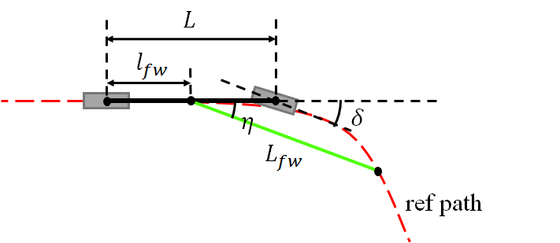
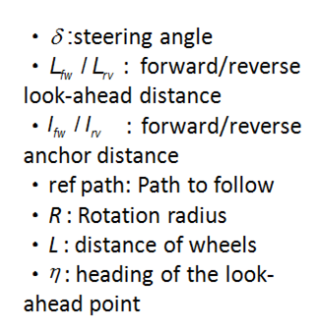
Communication & Control
L1 controller
paper: http://acl.mit.edu/papers/KuwataTCST09.pdf
paper: http://acl.mit.edu/papers/KuwataGNC08.pdf
https://hypharosworkshop.wordpress.com/
Copyright © 2017 Hypha ROS Workshop. All rights reserved
Lecturer: HaoChih, LIN

Slide 27
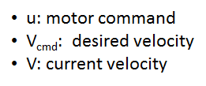

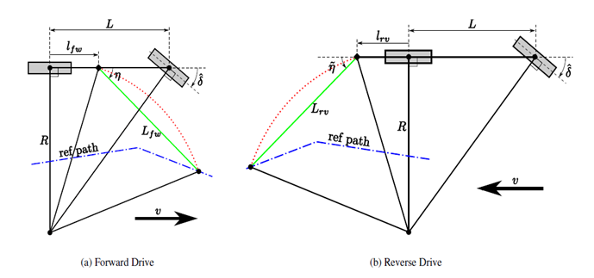
Communication & Control
L1 controller Implemenation
[source code] L1_controller.cpp
Speed control:
current version => constant spped
Path planning test
RACECAR_amcl_nav.launch
figure source: Yoshiaki Kuwata, Motion Planning in Complex Environments using Closed-loop Prediction
https://hypharosworkshop.wordpress.com/
Copyright © 2017 Hypha ROS Workshop. All rights reserved
Lecturer: HaoChih, LIN

Slide 28
Hardware Debug [optional]
https://hypharosworkshop.wordpress.com/
Copyright © 2017 Hypha ROS Workshop. All rights reserved
Lecturer: HaoChih, LIN

